Slide 1
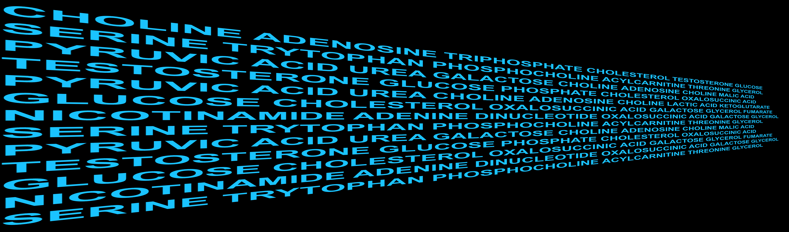

Activity Metabolomics
Gary Siuzdak

Slide 2
Modulating
Phenotype with Metabolites
Nature Methods 2017
Cell Metabolism 2018
Nature Protocols 2018
Cell Chemical Biology 2018
Nature Biotechnology 2018
Nature Chemical Biology 2018
Gary Siuzdak

Slide 3
Modulating
Phenotype with Metabolites
Nature Methods 2017
Cell Metabolism 2018
Nature Protocols 2018
Cell Chemical Biology 2018
Nature Biotechnology 2018
Nature Chemical Biology 2018
Gary Siuzdak

Slide 4
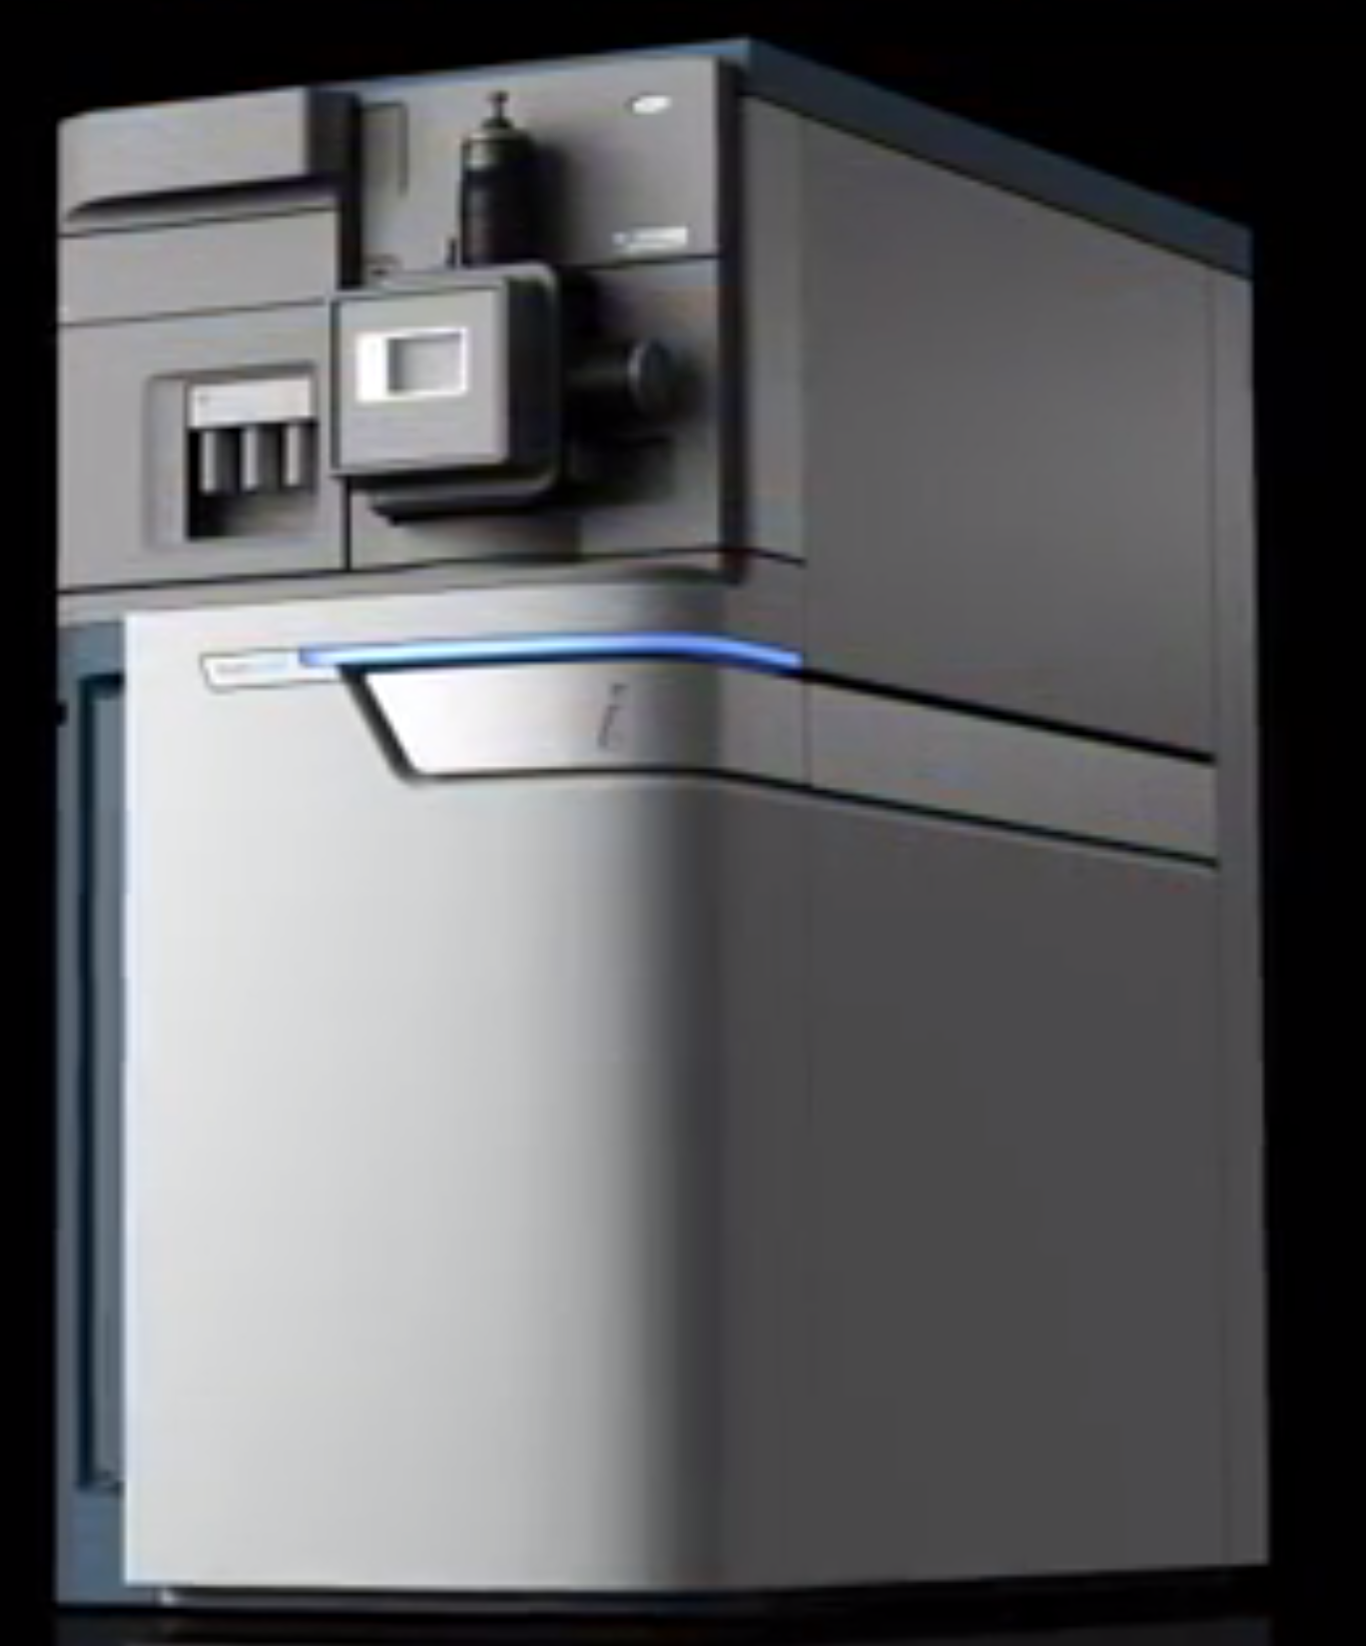
Modulating
Phenotype with Metabolites
Nature Methods 2017
Cell Metabolism 2018
Nature Protocols 2018
Cell Chemical Biology 2018
Nature Biotechnology 2018
Nature Chemical Biology 2018

Slide 5
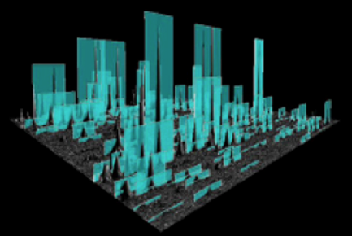
Modulating
Phenotype with Metabolites
Nature Methods 2017
Cell Metabolism 2018
Nature Protocols 2018
Cell Chemical Biology 2018
Nature Biotechnology 2018
Nature Chemical Biology 2018

Slide 6
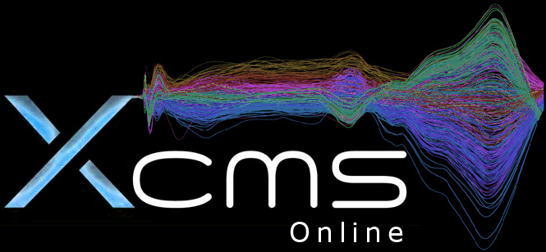
Modulating
Phenotype with Metabolites
Nature Methods 2017
Cell Metabolism 2018
Nature Protocols 2018
Cell Chemical Biology 2018
Nature Biotechnology 2018
Nature Chemical Biology 2018

Slide 7
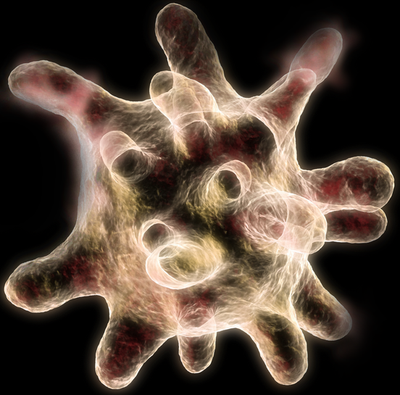
Modulating
Phenotype with Metabolites
Nature Methods 2017
Cell Metabolism 2018
Nature Protocols 2018
Cell Chemical Biology 2018
Nature Biotechnology 2018
Nature Chemical Biology 2018

Slide 8
XCMSOnline.scripps.edu

Slide 9
XCMSOnline.scripps.edu
23,000
Users

Slide 10
XCMS Online
XCMSOnline.scripps.edu
23,000
Users

Slide 11
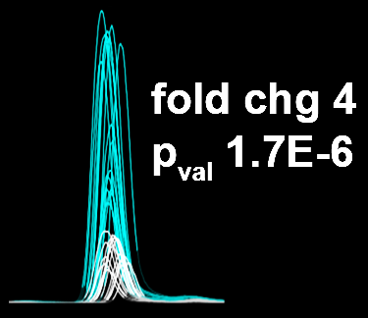
XCMS Online
XCMSOnline.scripps.edu
23,000
Users

Slide 12
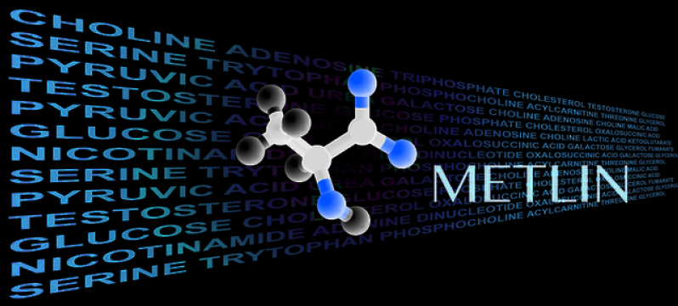
XCMS Online
XCMSOnline.scripps.edu
23,000
Users
METLIN.scripps.edu
METLIN

Slide 13
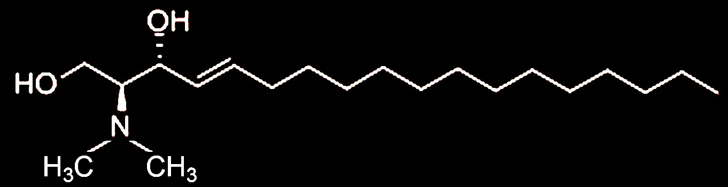
XCMS Online
XCMSOnline.scripps.edu
23,000
Users
METLIN.scripps.edu
METLIN

Slide 14
Modulating
Phenotype with Metabolites
Evolving since 1994

Slide 15
Modulating
Phenotype with Metabolites
Sleep
Evolving since 1994
Science 1995

Slide 16
Sleep
Metabolite
Identification
Science 1995

Slide 17
Sleep
Metabolite
Identification
Sleep
Metabolite
Identification
- Tandem MS
Science 1995

Slide 18
Sleep
Metabolite
Identification
Sleep
Metabolite
Identification
- Tandem MS
- Accurate m/z
- H/D Exchange
- Isotope Pattern
- Preparative LC for collection of metabolite for NMR
- Elemental composition of MS² and MS³ fragment ions
- Synthesize authentic standard
Science 1995

Slide 19
Sleep
Sleep
Metabolite
Identification
- Tandem MS
- Accurate m/z
- H/D Exchange
- Isotope Pattern
- Preparative LC for collection of metabolite for NMR
- Elemental composition of MS² and MS³ fragment ions
- Synthesize authentic standard
~ 4 min oleamide induces a sleep-like state
Science 1995

Slide 20
Technology Introduction
~ 4 min oleamide induces a sleep-like state

Slide 21
Technology Introduction
~ 4 min oleamide induces a sleep-like state
It took about 8 months to identify oleamide

Slide 22
Technology Introduction
~ 4 min oleamide induces a sleep-like state
It took about 8 months to identify oleamide
METLIN
1 Million Molecules in METLIN

Slide 23
Technology Introduction
~ 4 min oleamide induces a sleep-like state
It took about 8 months to identify oleamide
METLIN
1 Million Molecules in METLIN
50,000 Standards with MS/MS data

Slide 24
Technology Introduction
~ 4 min oleamide induces a sleep-like state
It took about 8 months to identify oleamide
Within seconds we can now identify oleamide and most other metabolites
METLIN
1 Million Molecules in METLIN
50,000 Standards with MS/MS data

Slide 25
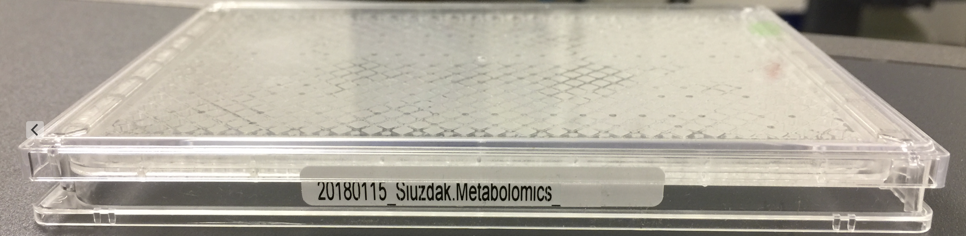
Technology Introduction
~ 4 min oleamide induces a sleep-like state
It took about 8 months to identify oleamide
Within seconds we can now identify oleamide and most other metabolites
METLIN
~1 million molecules
MS/MS
Standards w MS/MS data 14K to 30K

Slide 26

Technology Introduction
~ 4 min oleamide induces a sleep-like state
It took about 8 months to identify oleamide
METLIN
~1 million molecules
MS/MS
Standards w MS/MS data 14K to 30K

Slide 27
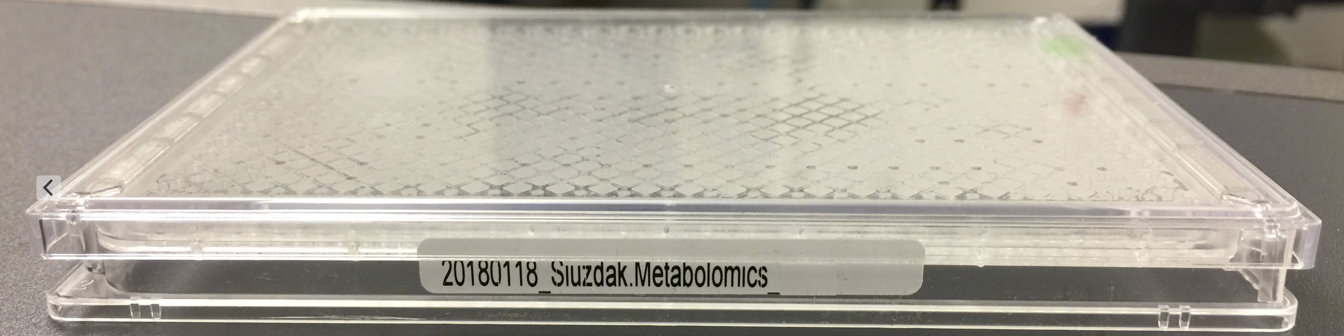
Technology Introduction
~ 4 min oleamide induces a sleep-like state
It took about 8 months to identify oleamide
METLIN
~1 million molecules
MS/MS
Standards w MS/MS data 14K to 30K

Slide 28
Modulating
Phenotype with Metabolites
Evolving
Since 2005
Nature Chem. Biol. 2010

Slide 29
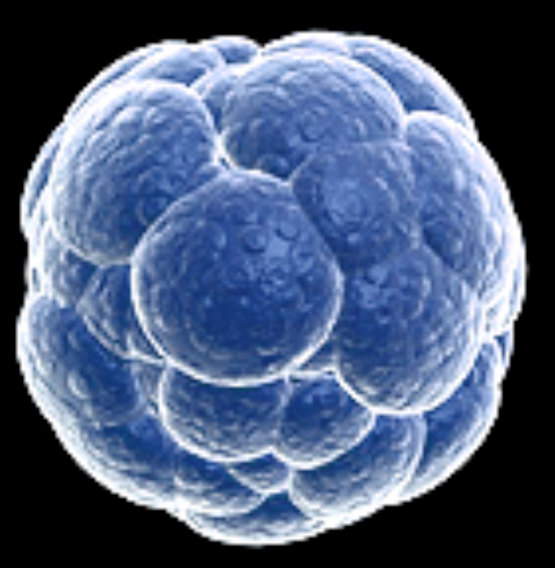
Modulating
Phenotype with Metabolites
stem cell differentiation
Evolving
Since 2005
Nature Chem. Biol. 2010

Slide 30
Modulating
Phenotype with Metabolites
stem cell
Evolving
Since 2005
Nature Chem. Biol. 2010

Slide 31
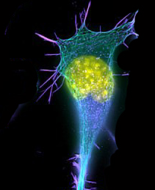
Modulating
Phenotype with Metabolites
stem cell
neurons
Evolving
Since 2005
Nature Chem. Biol. 2010

Slide 32
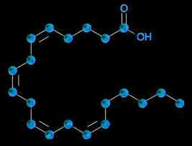
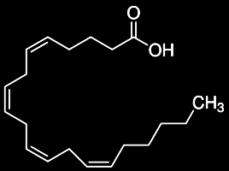
Modulating
Phenotype with Metabolites
neurons
Arachidonic Acid
Nature Chem. Biol. 2010

Slide 33
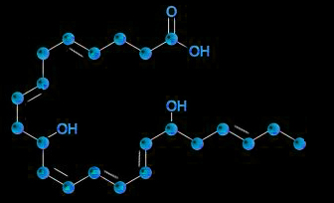
Modulating
Phenotype with Metabolites
neurons
Neuroprotectin D1
Nature Chem. Biol. 2010

Slide 34
Modulating
Phenotype with Metabolites
neurons
1500%
Neuroprotectin D1
Nature Chem. Biol. 2010

Slide 35
Technology Introduction
Sleep - METLIN ID
Stem -

Slide 36
Technology Introduction
Sleep - METLIN ID
Stem - XCMS Online

Slide 37
Technology Introduction
Sleep - METLIN ID
Stem - XCMS Online
Stem - XCMS Online

Slide 38
Technology Introduction
Stem - XCMS Online

Slide 39
Technology Introduction
Stem - XCMS Online

Slide 40
Technology Introduction
Stem - XCMS Online

Slide 41
Technology Introduction
Stem - XCMS Online
METLIN

Slide 42
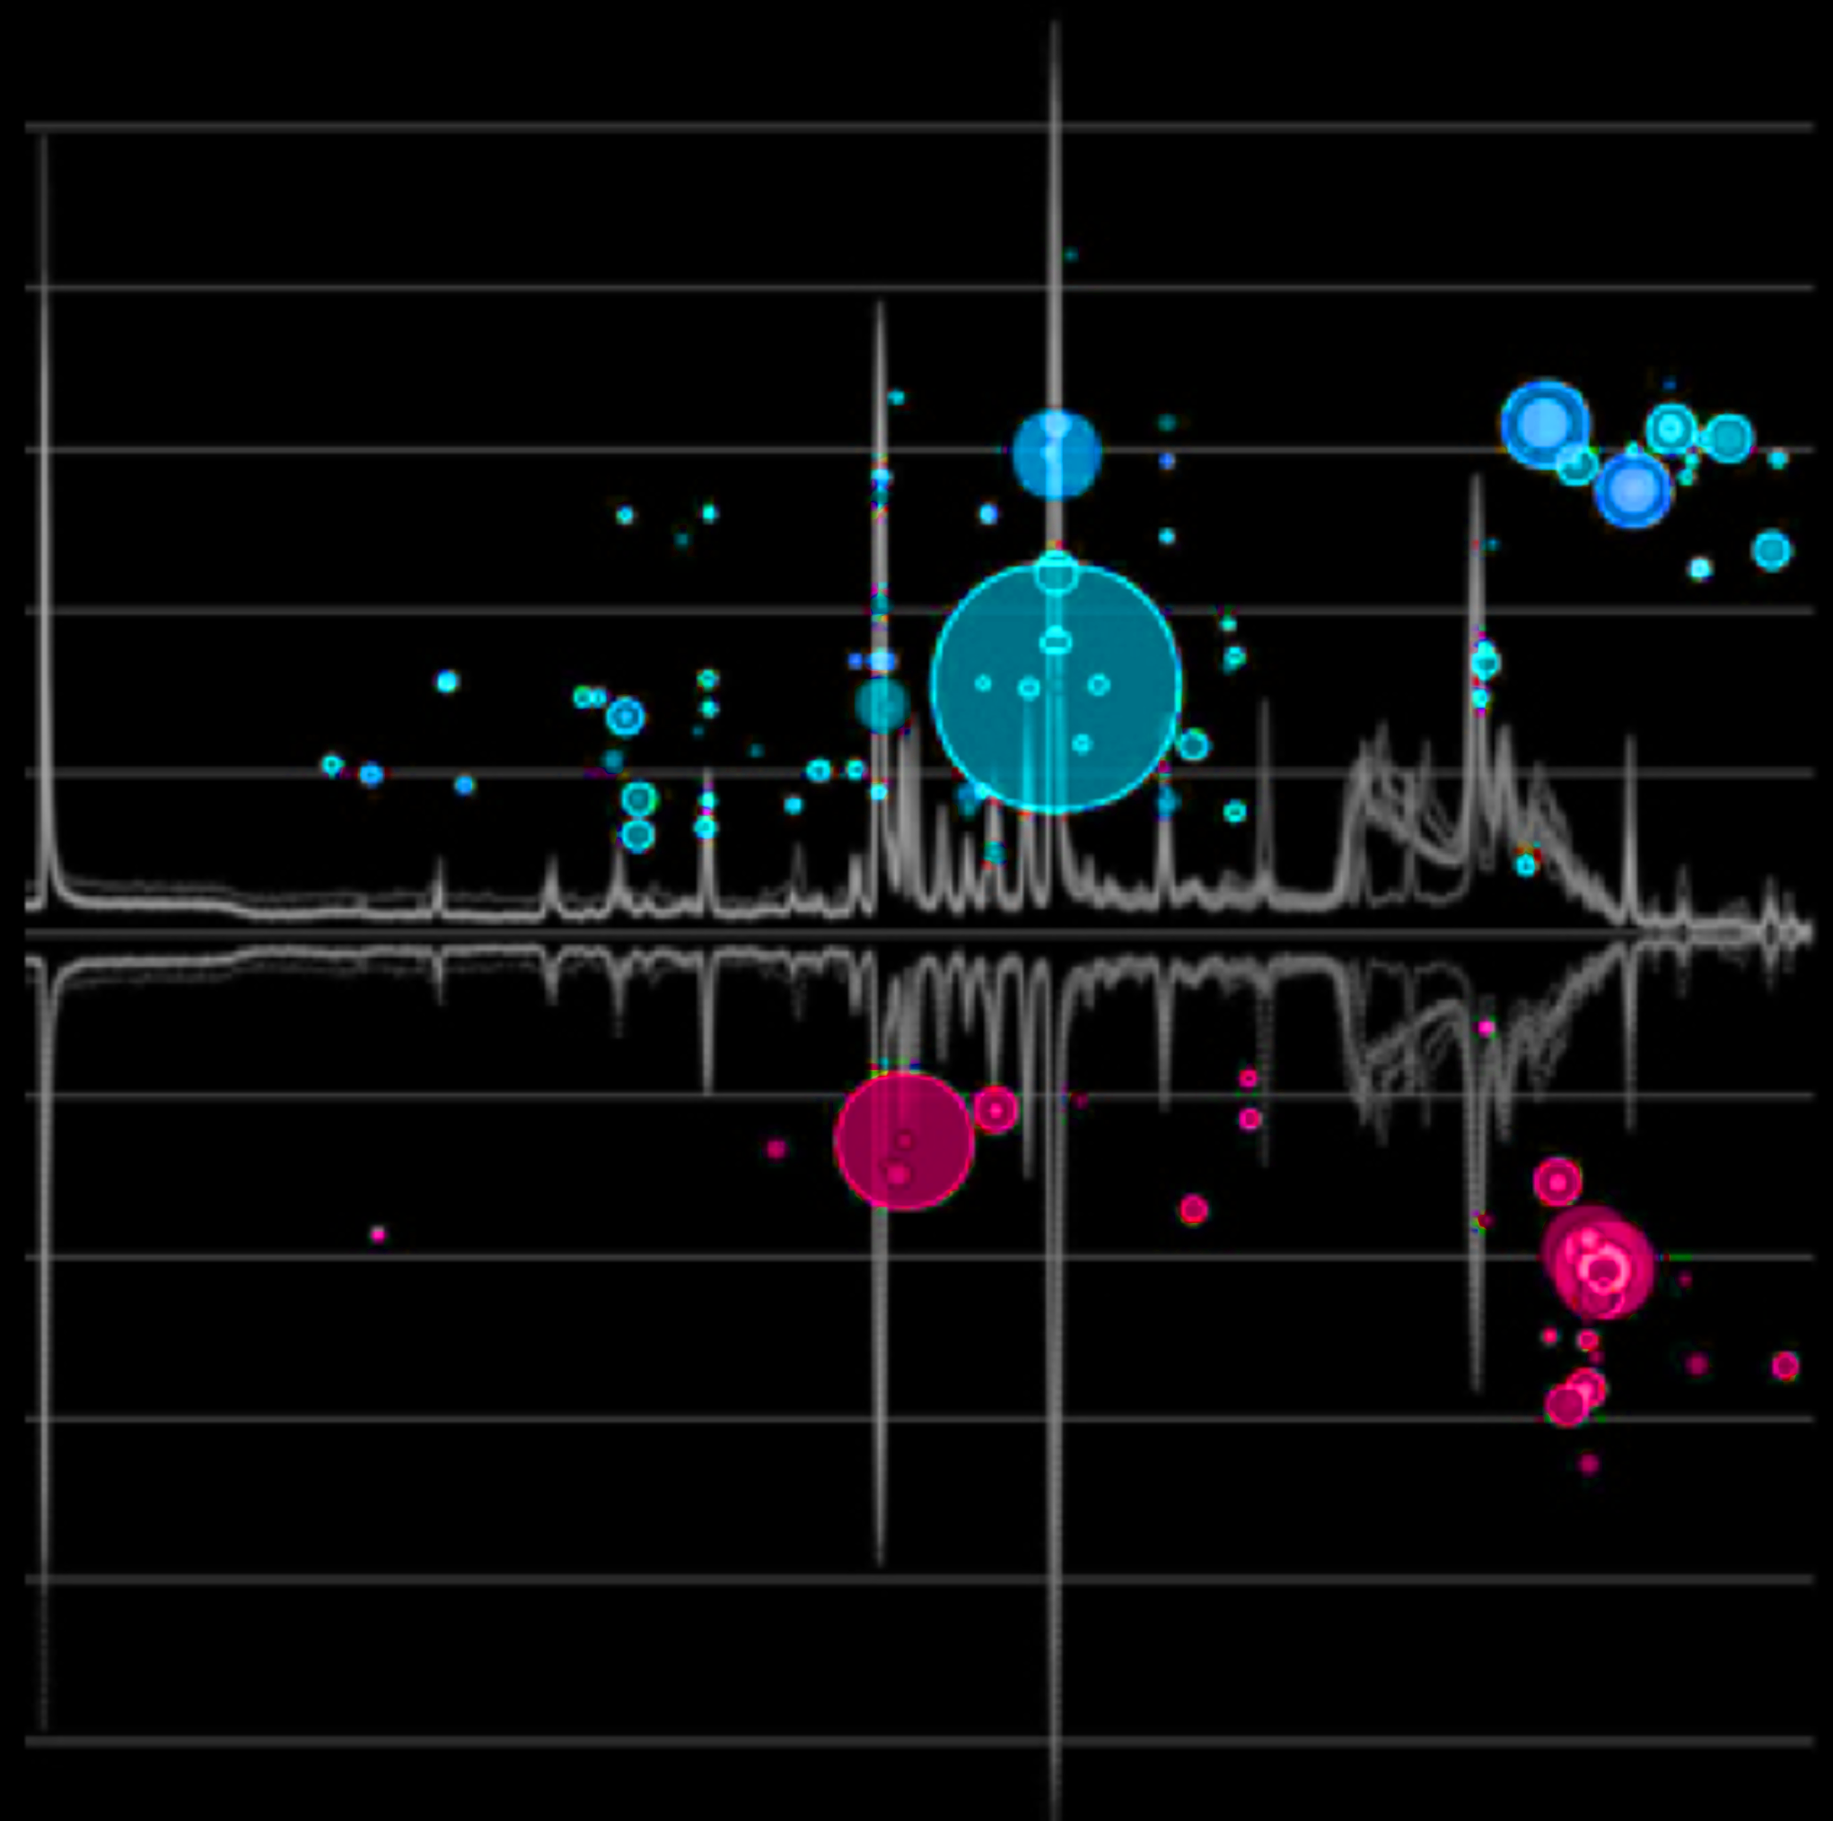
Pathway Analysis
Cloud Plot
Nature Methods 2017
Nature Protocols 2018
Nature Methods 2017

Slide 43
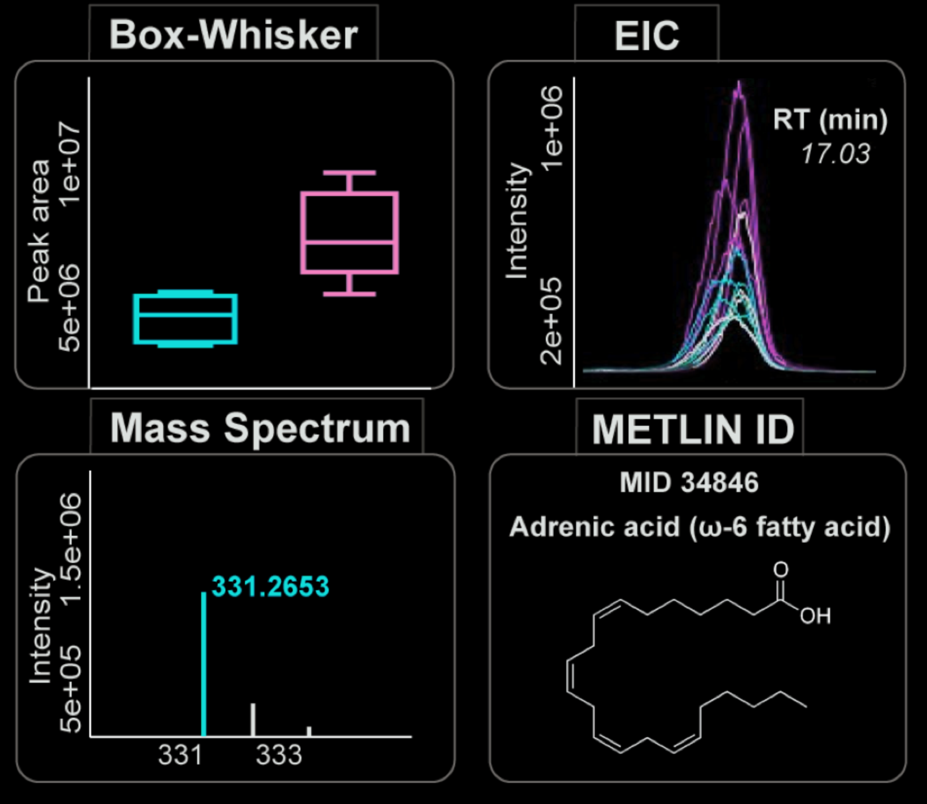
Pathway Analysis
Cloud Plot
Nature Methods 2017
Nature Protocols 2018
Nature Methods 2017

Slide 44

Pathway Analysis
Cloud Plot
Nature Methods 2017
Nature Protocols 2018
Nature Methods 2017

Slide 45
Pathway Analysis
Cloud Plot
Nature Methods 2017
Nature Protocols 2018
Nature Methods 2017

Slide 46
Pathway Analysis
Cloud Plot
Nature Methods 2017
Nature Protocols 2018
Nature Methods 2017

Slide 47
Modulating
Phenotype with Metabolites
Evolving since 2015
Cell Chem. Biol. 2018
Analytical Chemistry 2017

Slide 48
Modulating
Phenotype with Metabolites
Xenoestrogens
Endocrine Disruptors
Evolving since 2015
Cell Chem. Biol. 2018
Analytical Chemistry 2017

Slide 49
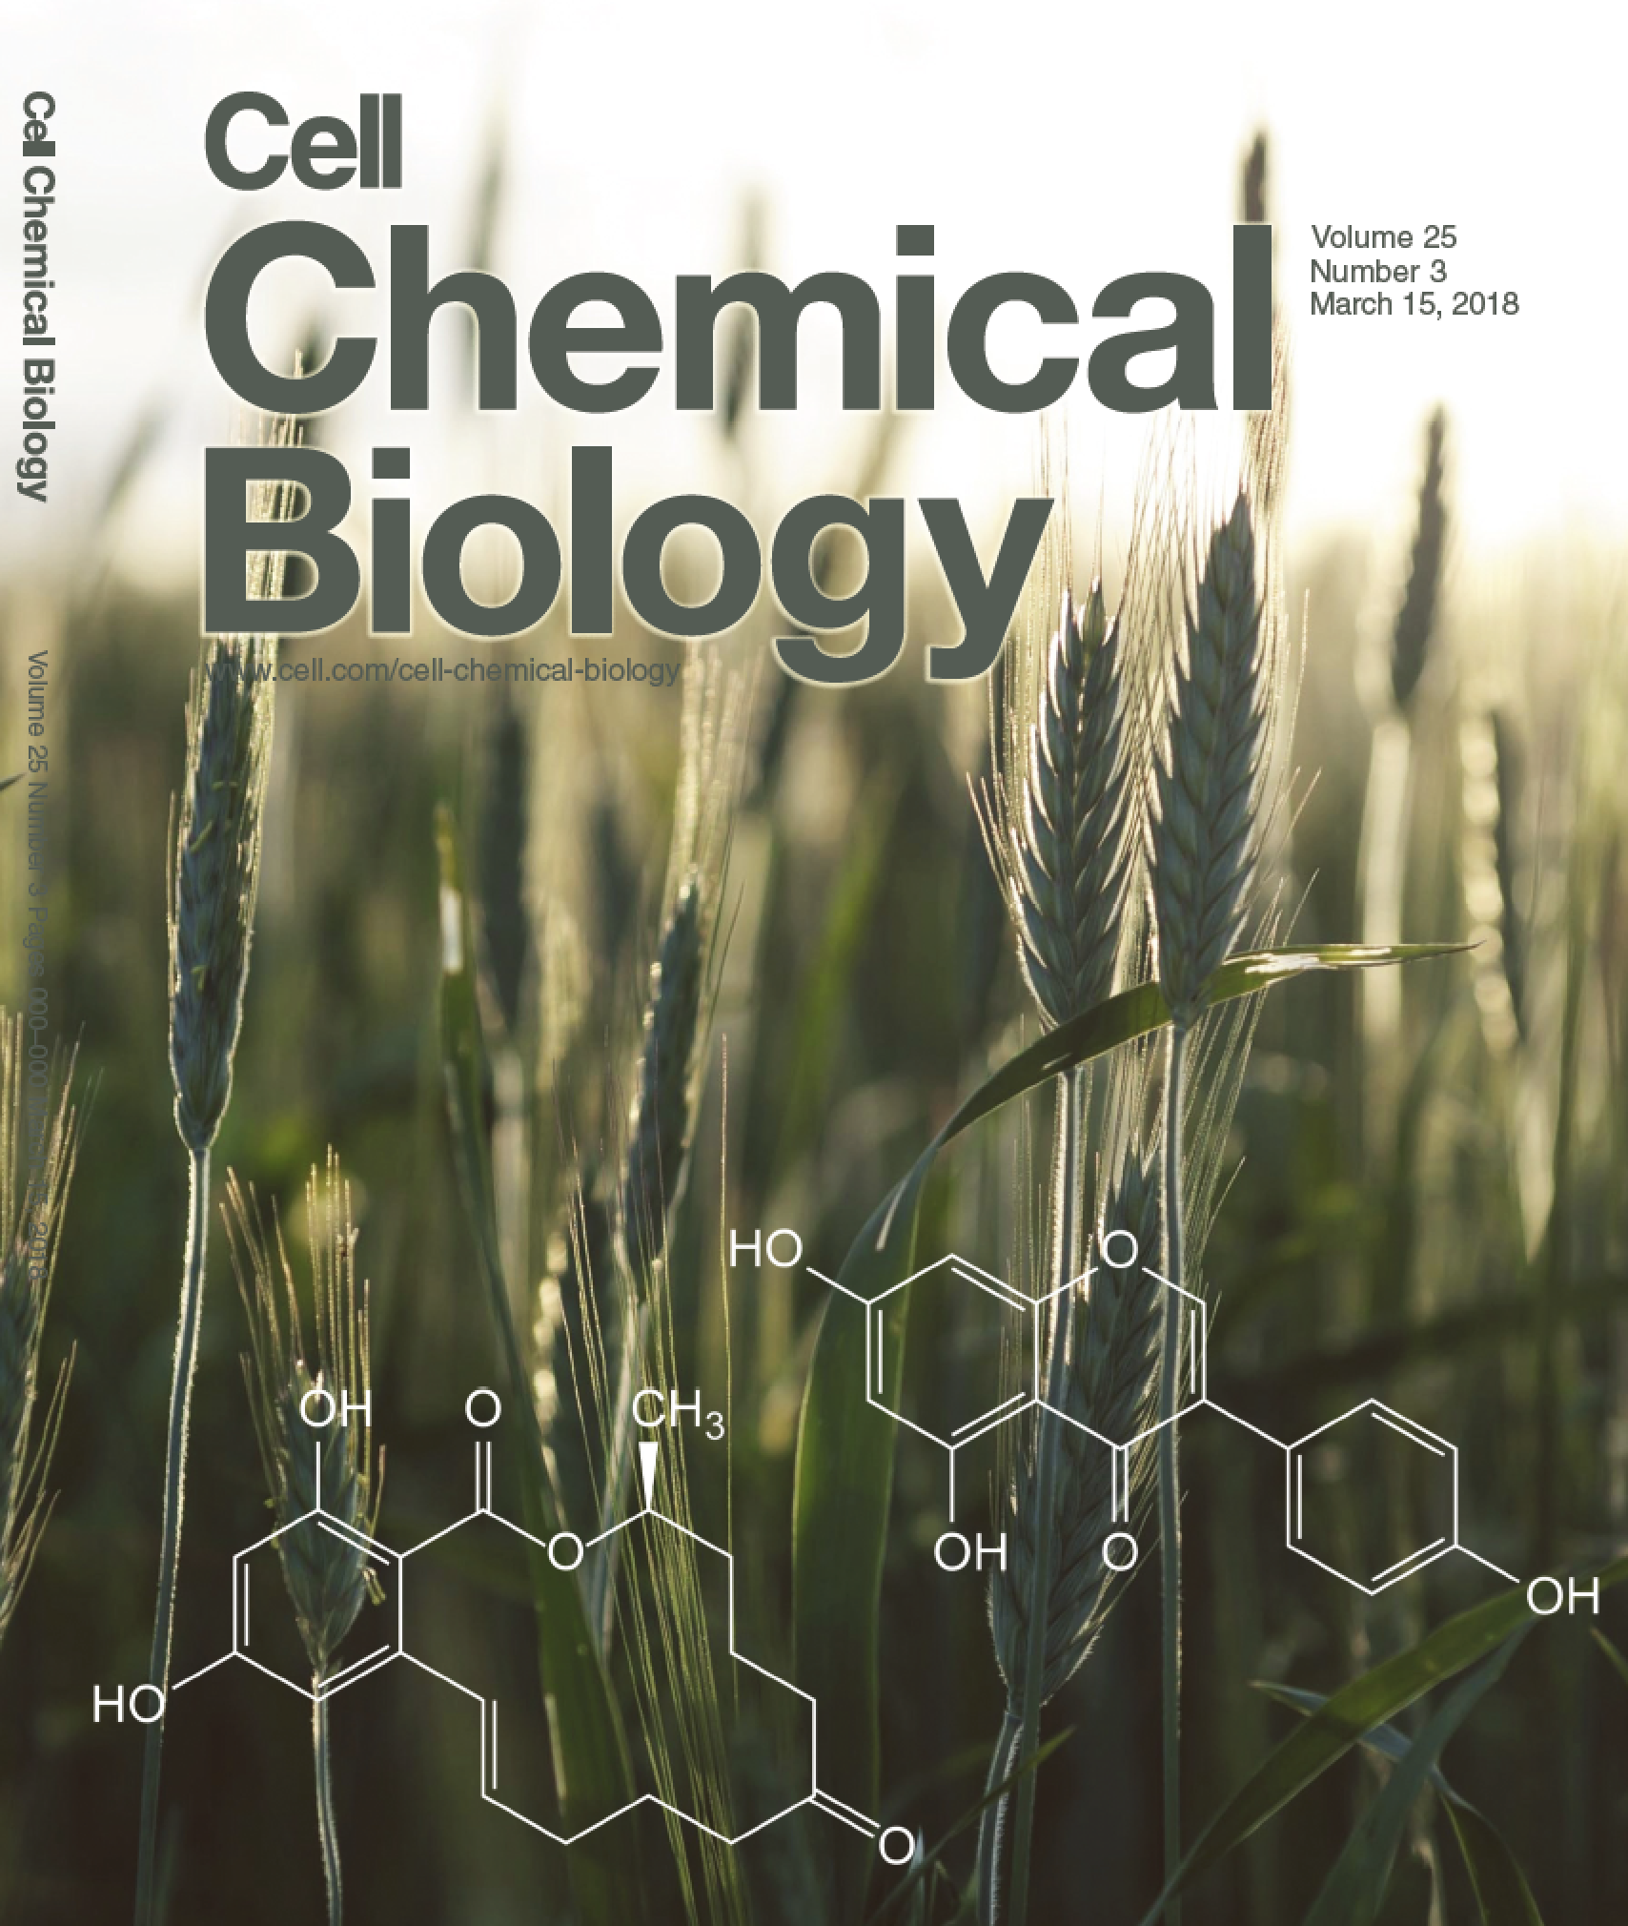
Modulating
Phenotype with Metabolites
Xenoestrogens
Endocrine Disruptors
Evolving since 2015
Cell Chem. Biol. 2018
Analytical Chemistry 2017

Slide 50
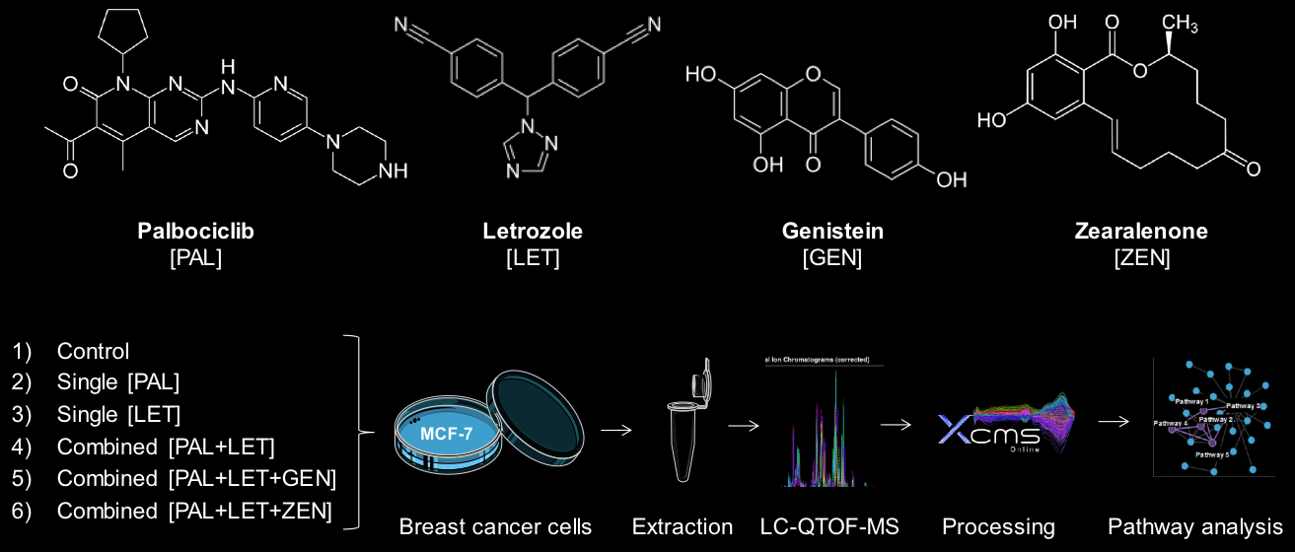
Modulating
Phenotype with Metabolites
FDA Approved
Drug Combination
Estrogen Receptor positive
Breast Cancer

Slide 51
Modulating
Phenotype with Metabolites
FDA Approved
Drug Combination
Estrogen Receptor positive
Breast Cancer
Xenoestrogens

Slide 52
Modulating
Phenotype with Metabolites
FDA Approved
Drug Combination
Estrogen Receptor positive
Breast Cancer
Xenoestrogens

Slide 53
Modulating
Phenotype with Metabolites
FDA Approved
Drug Combination
Estrogen Receptor positive
Breast Cancer
Xenoestrogens

Slide 54
Modulating
Phenotype with Metabolites
Drug Combination
Estrogen Receptor positive
Breast Cancer
Xenoestrogens

Slide 55
Modulating
Phenotype with Metabolites
Drug Combination
Xenoestrogens

Slide 56
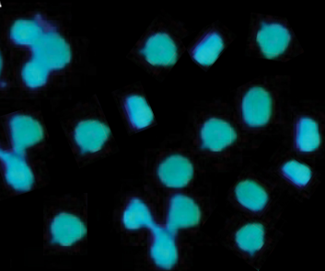
Exposure
MCF-7

Slide 57
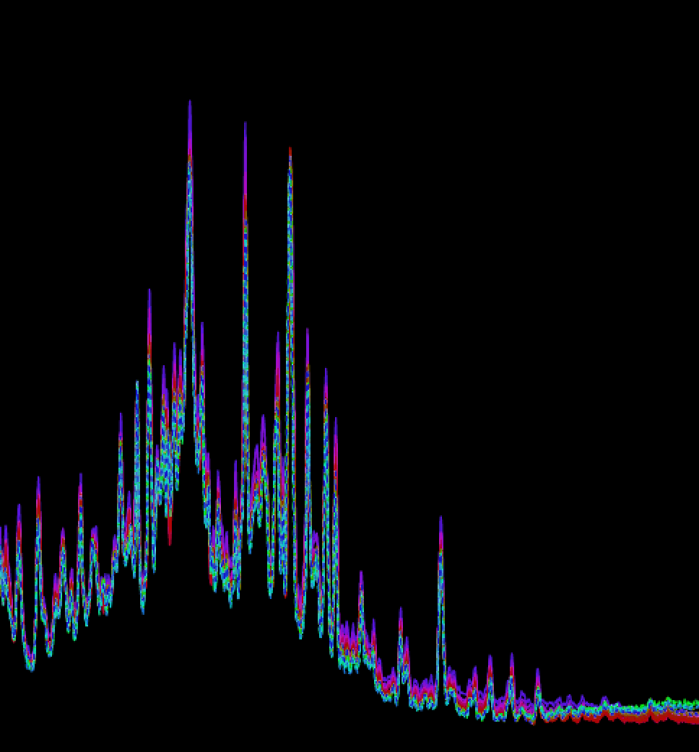
Exposure
MCF-7
Nature Methods 2017 & Nature Protocols 2018

Slide 58
Exposure
MCF-7
Nature Methods 2017 & Nature Protocols 2018

Slide 59
Exposure
MCF-7
Nature Methods 2017 & Nature Protocols 2018

Slide 60
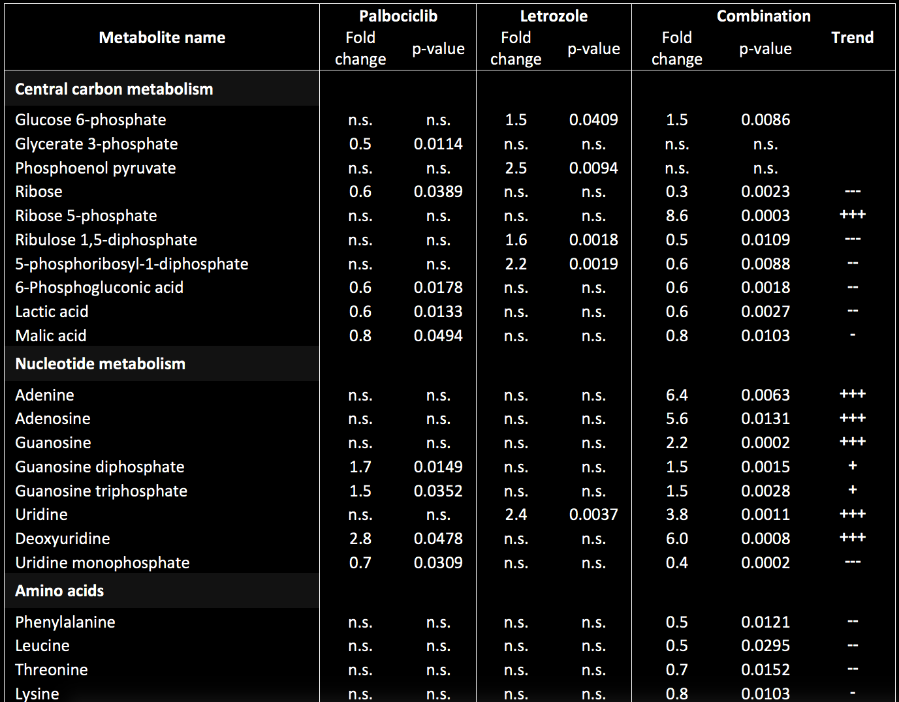
Exposure
MCF-7

Slide 61
Exposure
MCF-7

Slide 62
Exposure
MCF-7

Slide 63
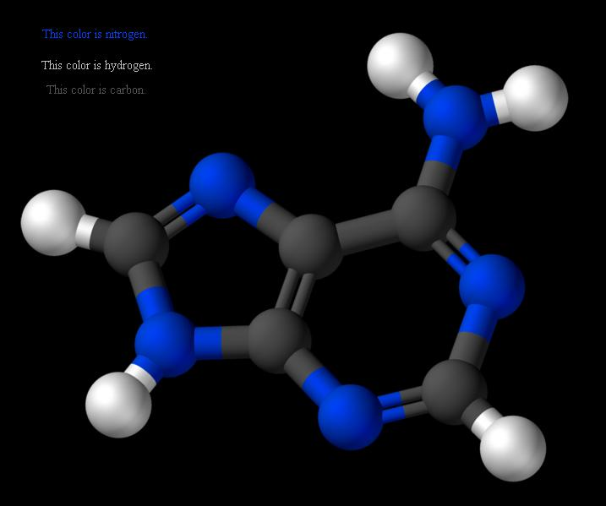
Exposure
Xenoestrogens
Adenine
MCF-7

Slide 64
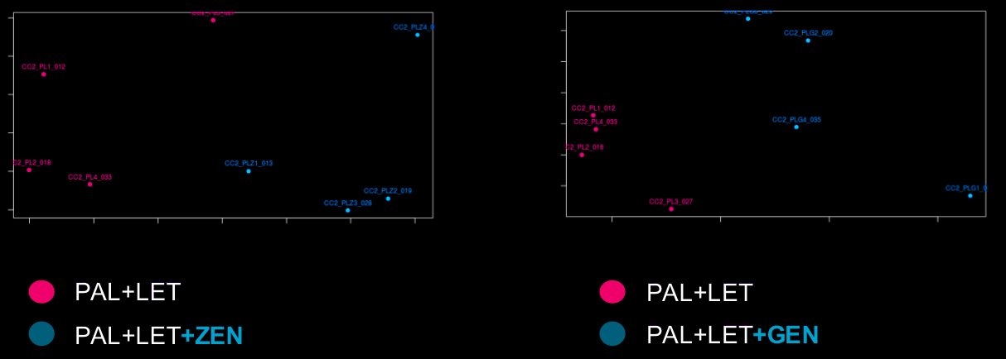
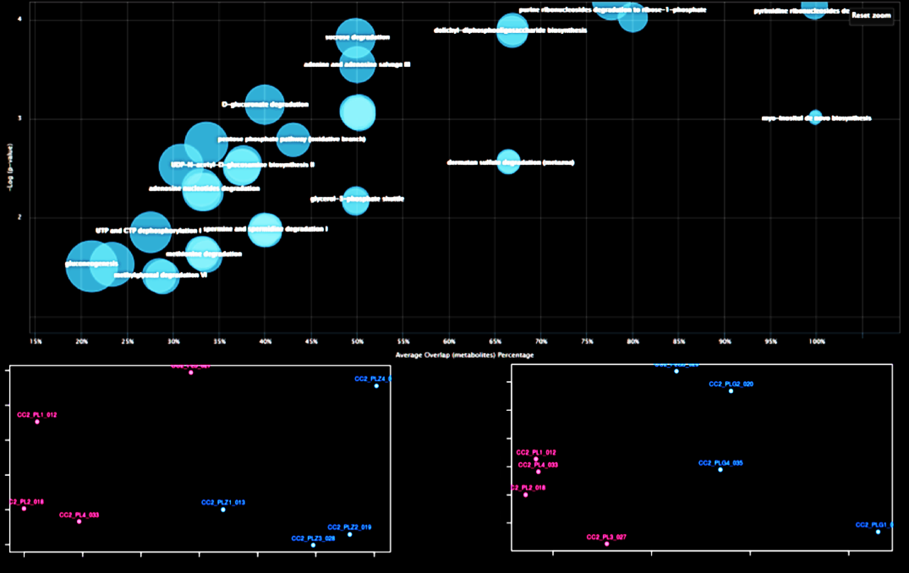
Exposure
Xenoestrogens
Adenine
MCF-7

Slide 65
Exposure
Xenoestrogens
Adenine

Slide 66
Technology Introduction
Sleep - METLIN ID
Stem - XCMS Online
EDCs -

Slide 67

Technology Introduction
Sleep - METLIN ID
Stem - XCMS Online
EDCs - AI with

Slide 68
Analytical Chemistry 2017

Slide 69
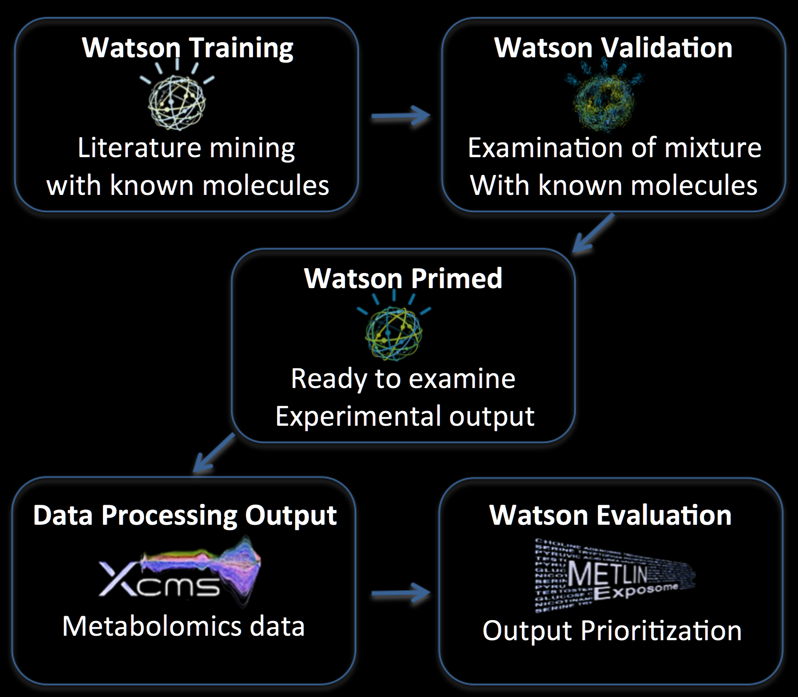
Analytical Chemistry 2017

Slide 70
Analytical Chemistry 2017

Slide 71
Analytical Chemistry 2017

Slide 74
IBM
Watson
Analytical Chemistry 2017

Slide 75
IBM
Watson
• hundreds to thousands of metabolites
Analytical Chemistry 2017

Slide 76
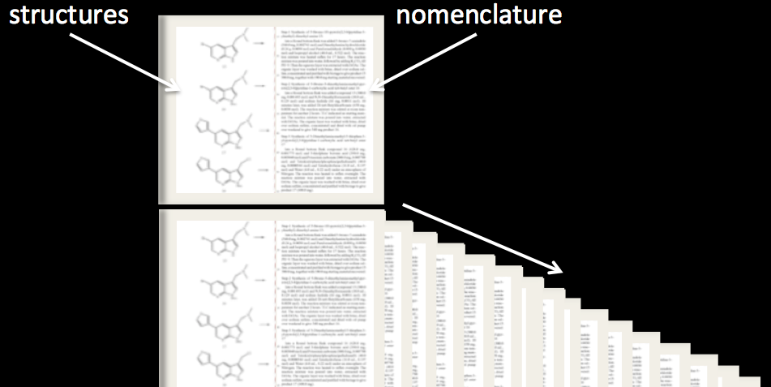
IBM
Watson
• hundreds to thousands of metabolites
• hundreds to thousands
of metabolites
• ranked molecules
from 300K papers

Slide 77
IBM
Watson
• hundreds to thousands of metabolites
• hundreds to thousands
of metabolites
• ranked molecules
from 300K papers
• ~4 hrs processing

Slide 78
Modulating
Phenotype with Metabolites
Evolving
Since 2016

Slide 79
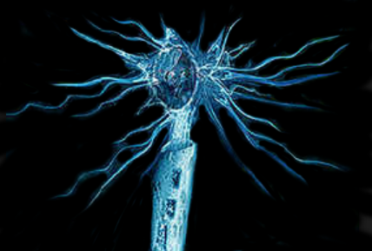
Modulating
Phenotype with Metabolites
Multiple Sclerosis
Nature Chem. Biol. 2018
Nature 2013 (Lairson)

Slide 80

Modulating
Phenotype with Metabolites
Multiple Sclerosis
Nature Chem. Biol. 2018
Nature 2013 (Lairson)
Luke Lairson

Slide 81
Multiple Sclerosis
Nature Chem. Biol. 2018
Nature 2013 (Lairson)
Luke Lairson

Slide 82
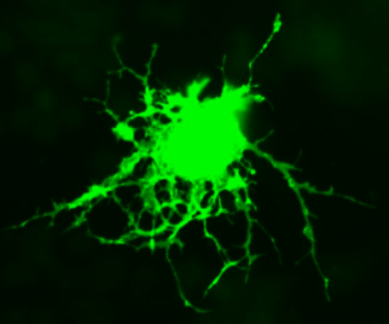
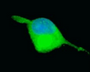
Multiple Sclerosis
precursor
oligodendrocyte
differentiation
Nature Chem. Biol. 2018
Nature 2013 (Lairson)
Luke Lairson

Slide 83
Multiple Sclerosis
METLIN
precursor
oligodendrocyte
differentiation
Nature Chem. Biol. 2018
Nature 2013 (Lairson)
Luke Lairson

Slide 84
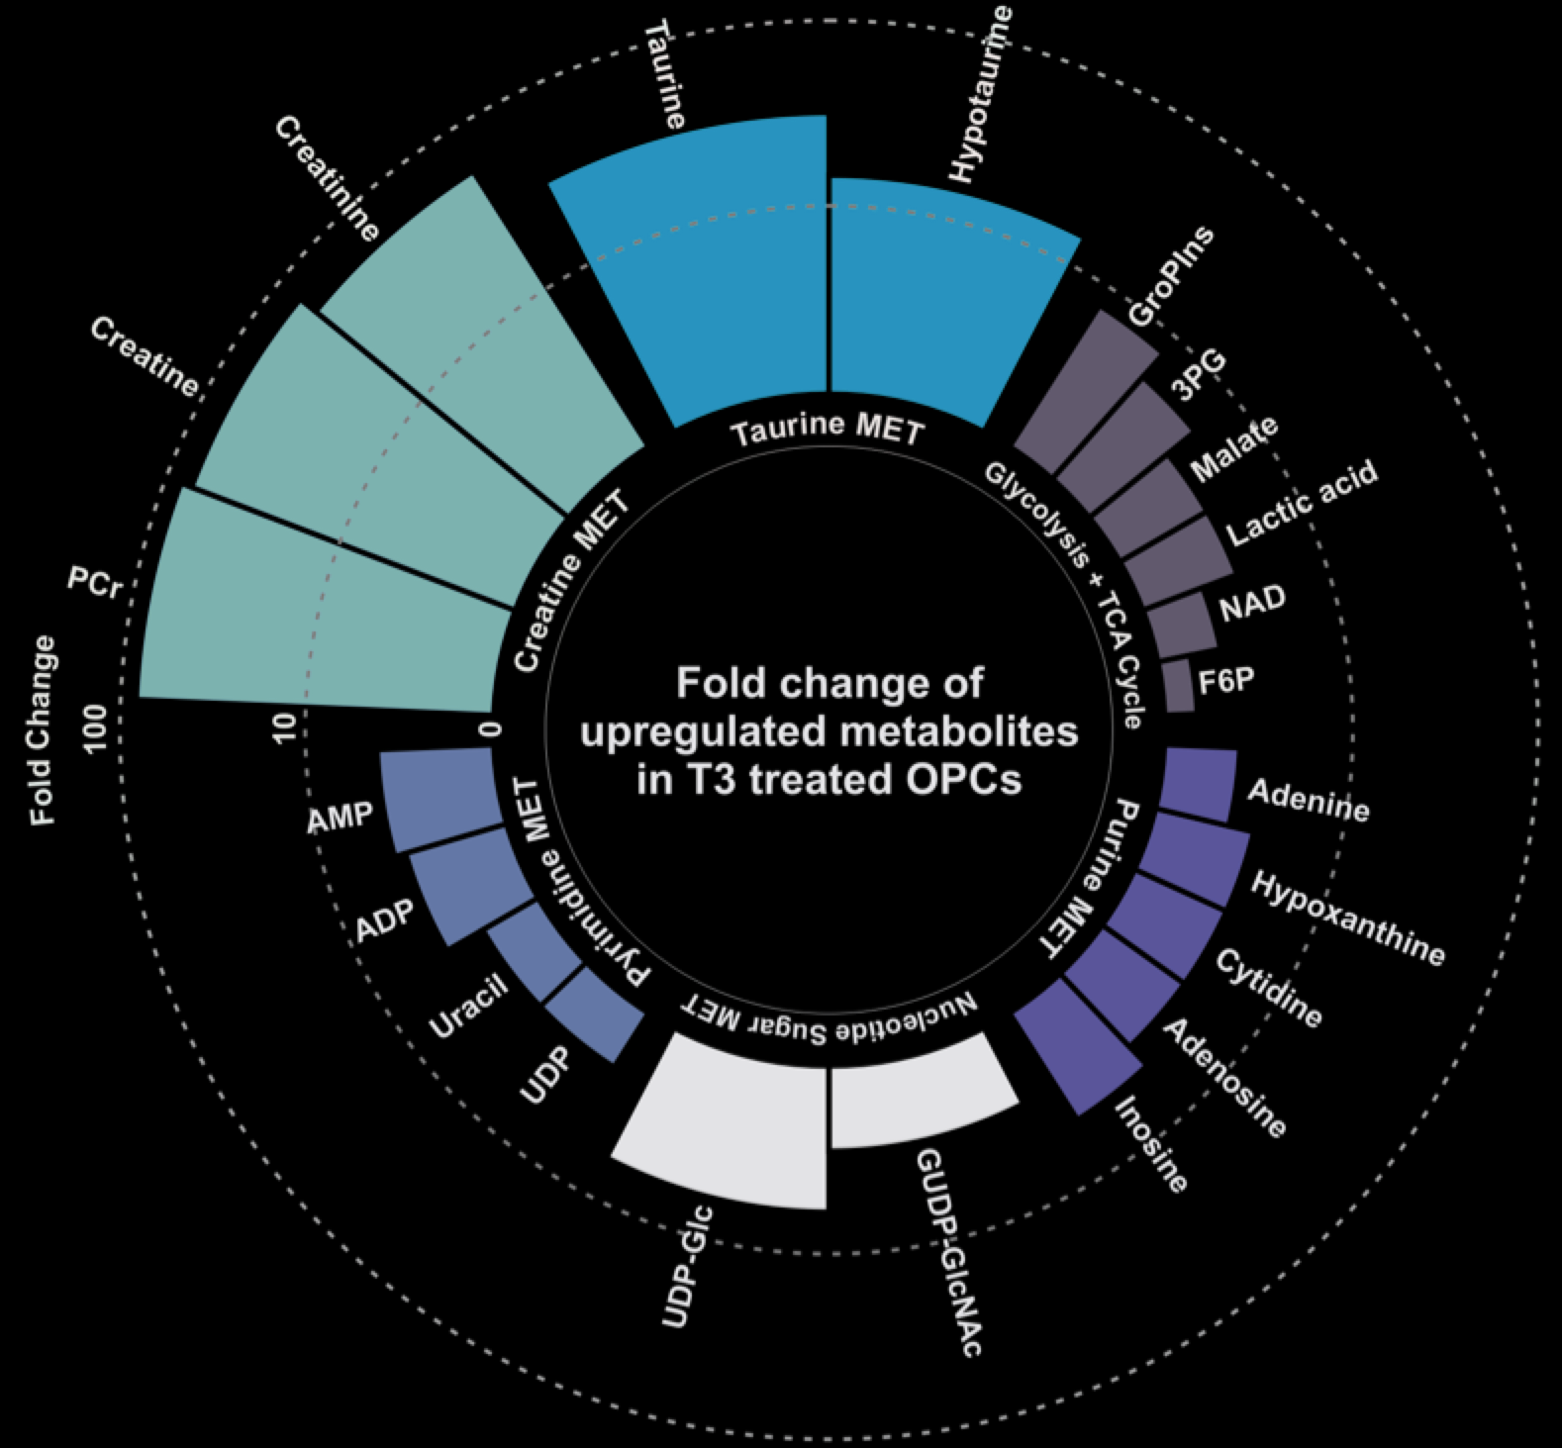
Multiple Sclerosis
METLIN
precursor
oligodendrocyte
differentiation

Slide 85
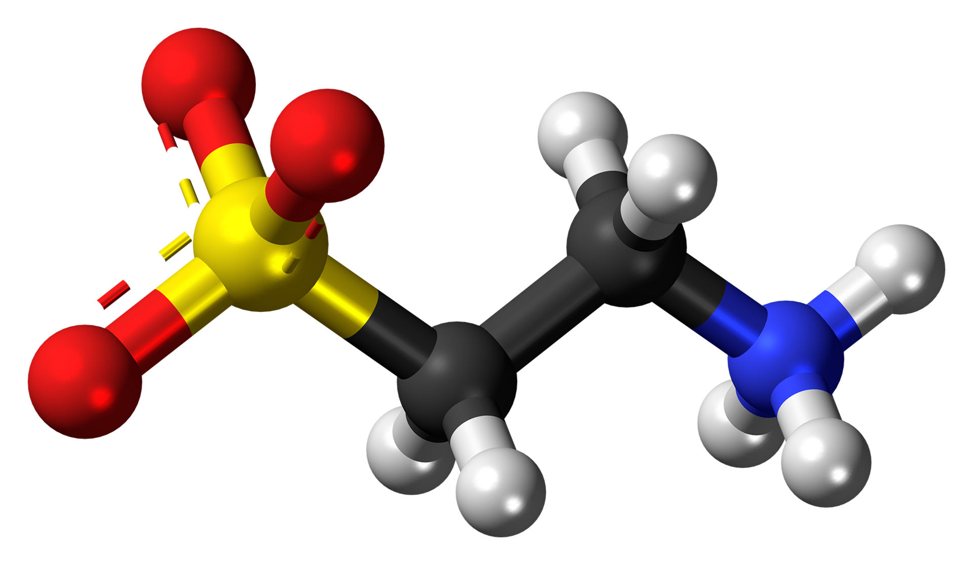
Multiple Sclerosis
METLIN
precursor
oligodendrocyte
differentiation

Slide 86
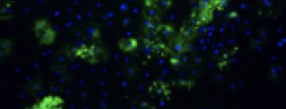
Multiple Sclerosis
METLIN
precursor
oligodendrocyte
differentiation
Oligodendrocyte
without Taurine

Slide 87
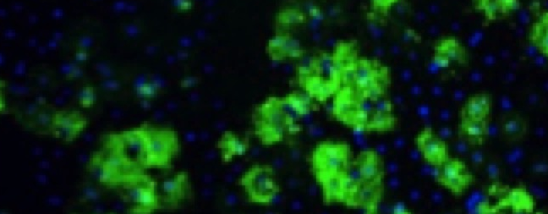
Multiple Sclerosis
METLIN
precursor
oligodendrocyte
differentiation
Oligodendrocyte
without Taurine
Oligodendrocyte
with Taurine
40 140
m/z

Slide 88
Multiple Sclerosis
METLIN
precursor
oligodendrocyte
differentiation
Oligodendrocyte
without Taurine
Oligodendrocyte
with Taurine
250% increase

Slide 89
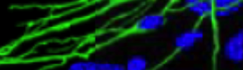
Multiple Sclerosis
METLIN
precursor
oligodendrocyte
differentiation
Oligodendrocyte
without Taurine
Myelin Sheath
Neuron regeneration

Slide 90
Multiple Sclerosis
METLIN
precursor
oligodendrocyte
differentiation
Recent results - neuron regeneration in vivo
Myelin Sheath
Neuron regeneration

Slide 91
Multiple Sclerosis
METLIN
precursor
oligodendrocyte
differentiation
Recent results - neuron regeneration in vivo
Myelin Sheath
Neuron regeneration

Slide 92
Technology Introduction
Sleep - METLIN ID
Stem - XCMS Online
EDCs - AI with
Neurons -

Slide 93
Technology Introduction
Sleep - METLIN ID
Stem - XCMS Online
EDCs - AI with
Neurons - Sys. Bio.

Slide 94
Modulating
Phenotype with Metabolites
Evolving
Since 2010

Slide 95
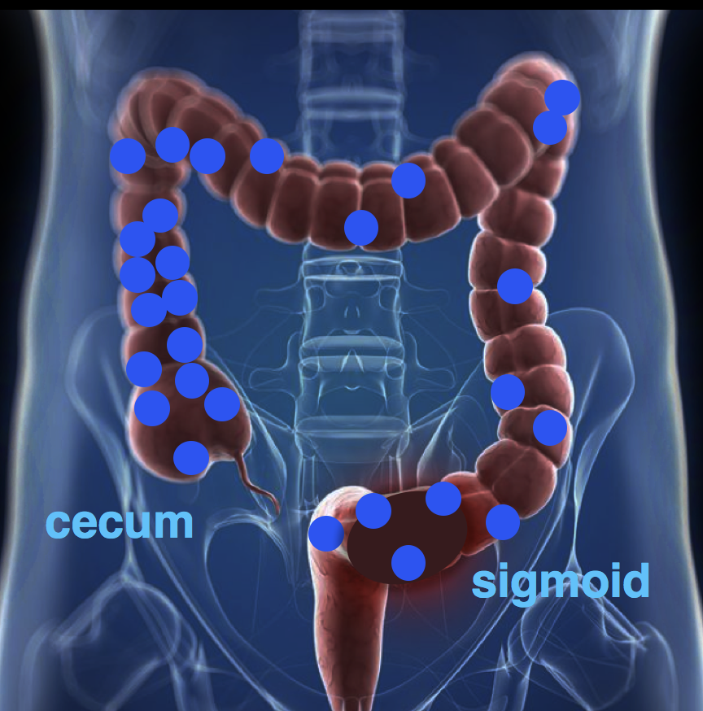
Modulating
Phenotype with Metabolites
Colorectal
Cancer
Evolving
Since 2010

Slide 96
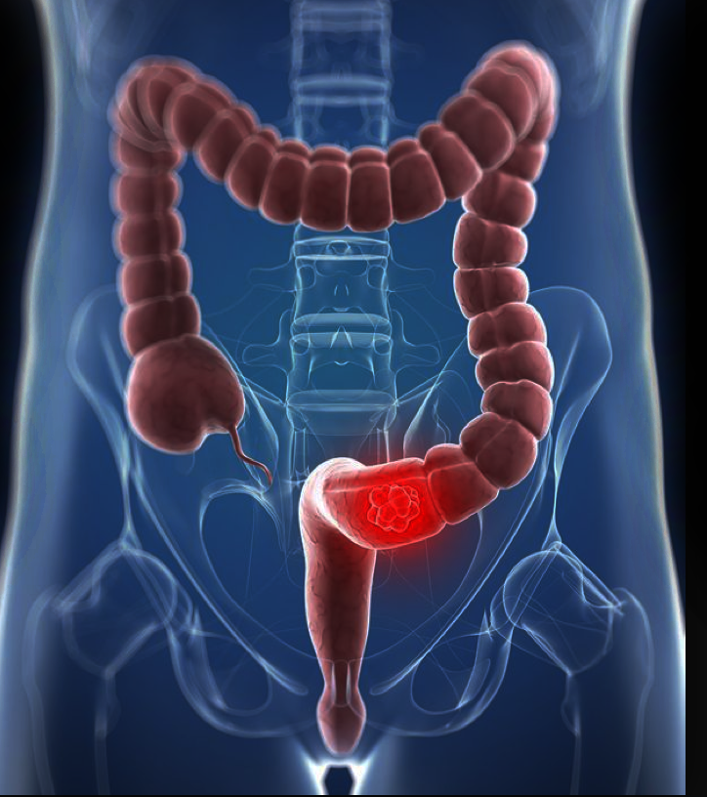
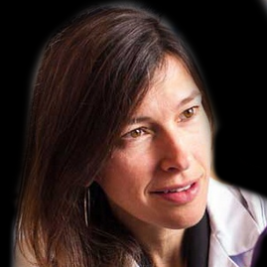

Colorectal Cancer
Mass Spectrometry-based metabolomic analysis
David Elder
Karolinska
Cynthia Sears
Johns Hopkins
cecum
sigmoid
tumors
Laura Goetz
UCSD
Caroline Johnson
Yale University
Cell Metabolism 2015

Slide 97
Colorectal Cancer
Mass Spectrometry-based metabolomic analysis
Up
regulated
Down
regulated
m/z
Retention Time
cecum
sigmoid
tumors
Cell Metabolism 2015

Slide 98
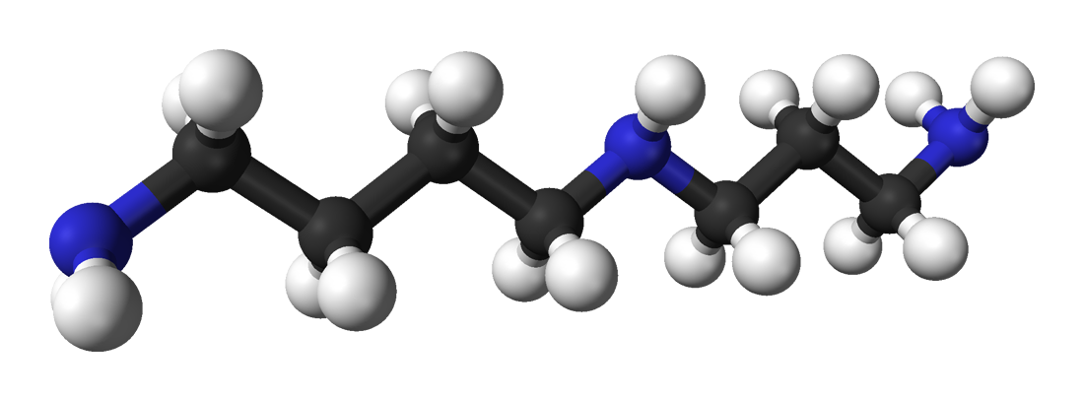
Colorectal Cancer
Mass Spectrometry-based metabolomic analysis
Up
regulated
m/z
cecum
sigmoid
Polyamines
tumors
Cell Metabolism 2015

Slide 99
Polyamines

Slide 100
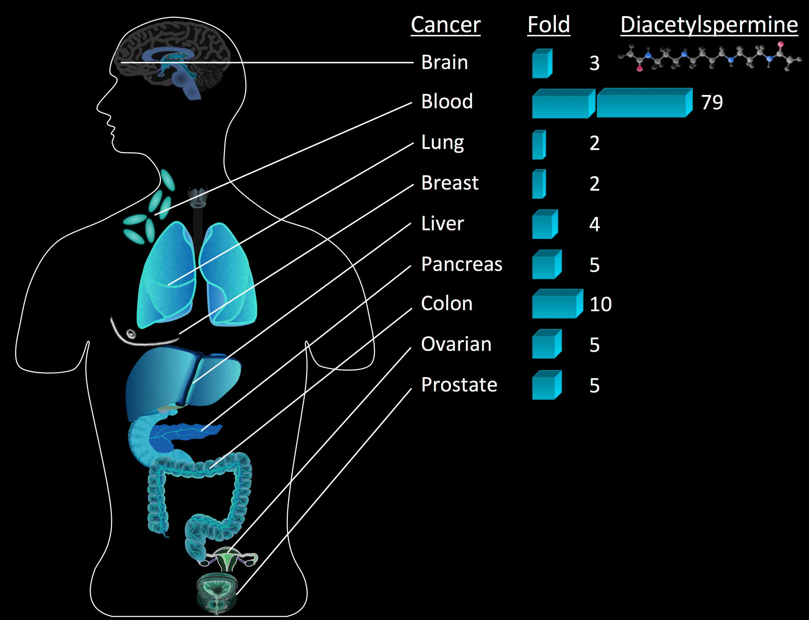
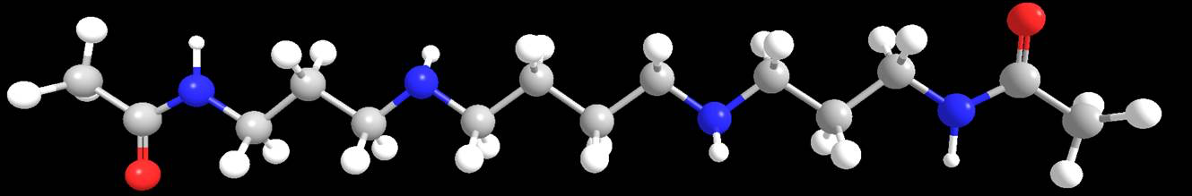
Polyamines
average
12-fold
increase
Why?

Slide 101
Polyamines
polyamines
Why?

Slide 102
Polyamines

Slide 103
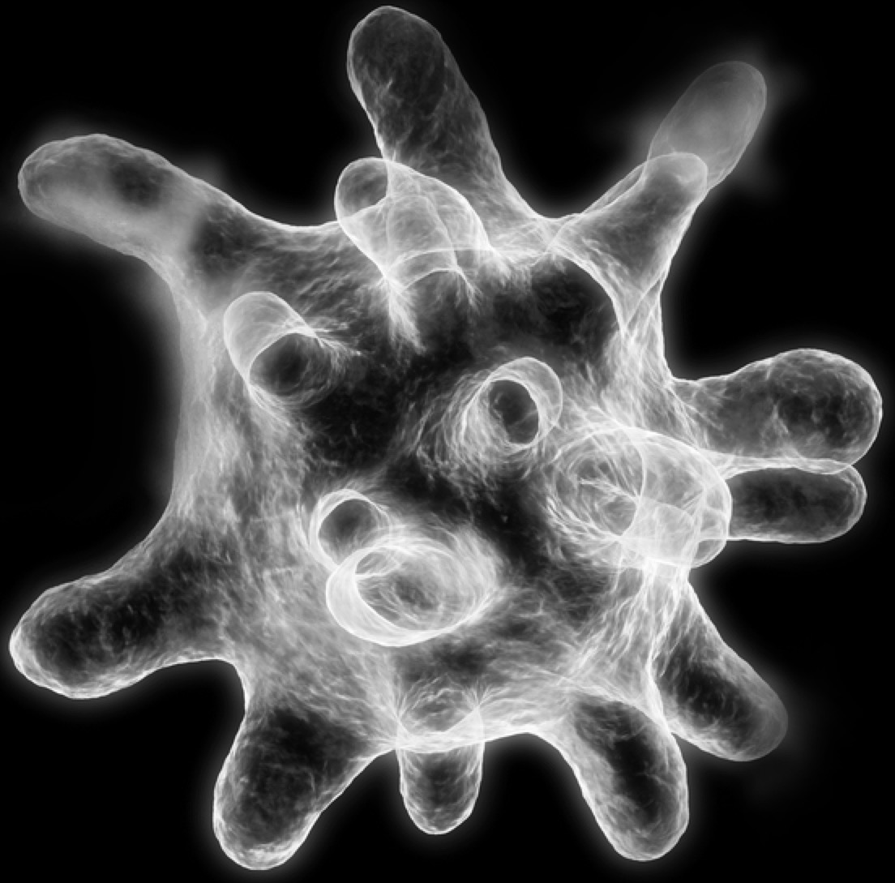
Polyamines
Macrophages

Slide 104
Polyamines
Macrophages

Slide 105
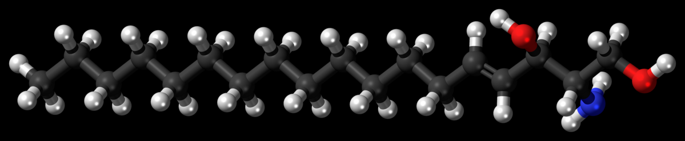
Polyamines
Macrophages
Unknown Lipids

Slide 106
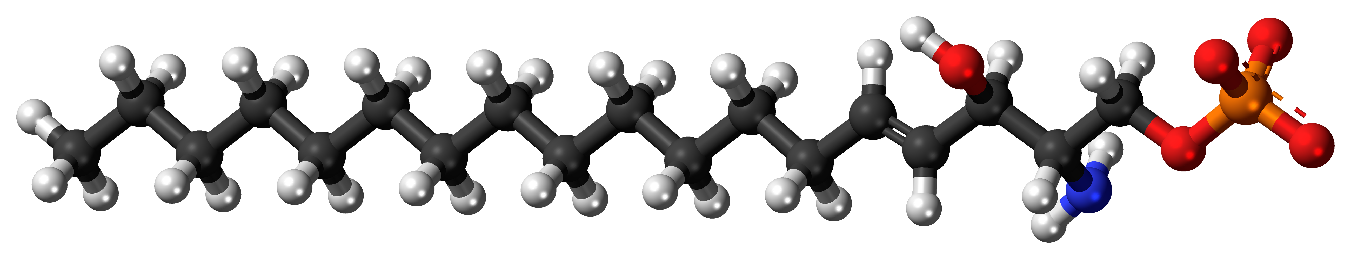
Polyamines
Macrophages
Unknown Lipids
S1P

Slide 107
Microbiome
and IBD
free bonus

Slide 108
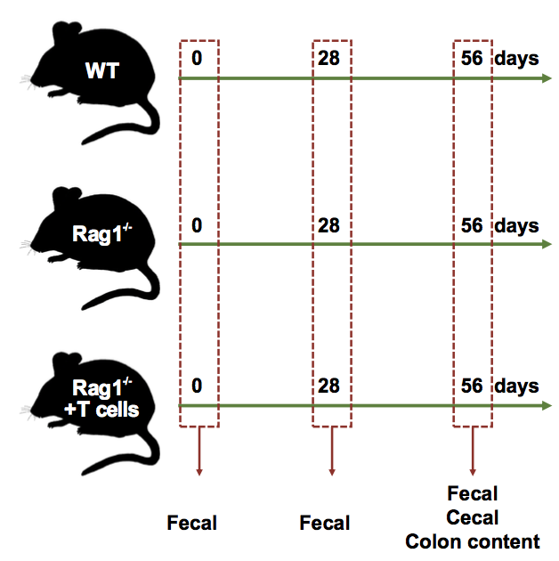
Microbiome
and IBD
Untargeted
Metabolomics

Slide 109
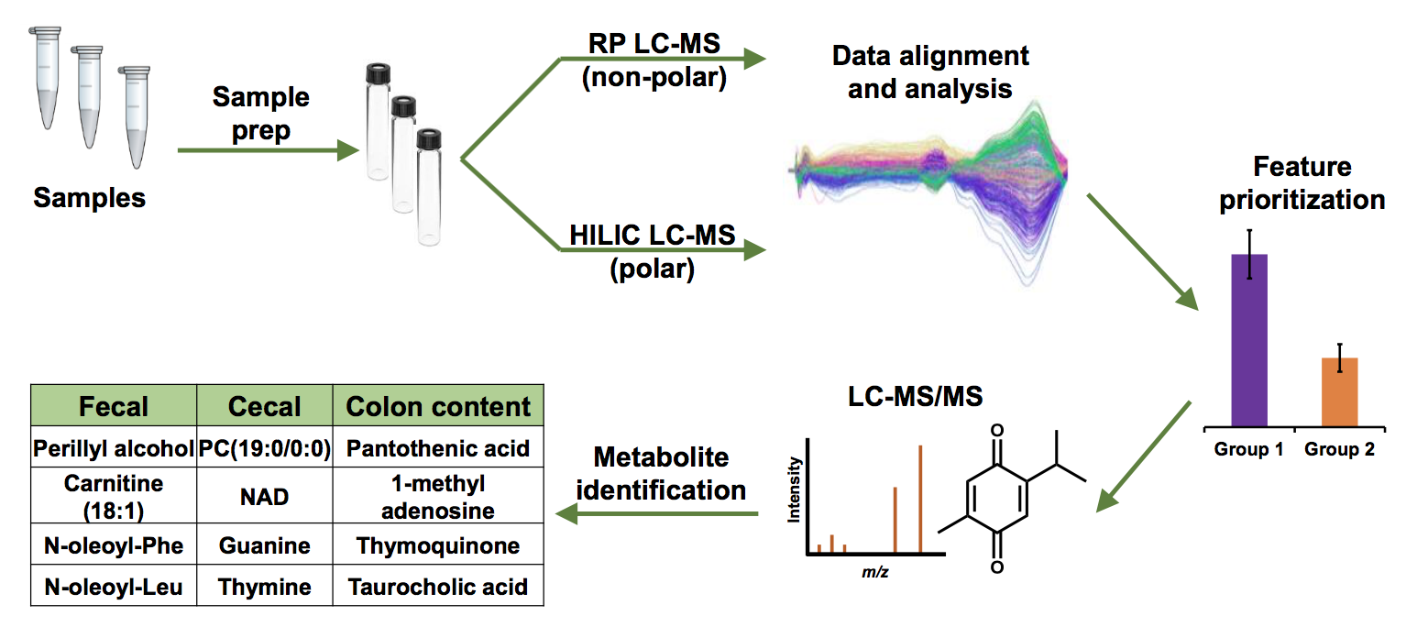
Microbiome
and IBD
Untargeted
Metabolomics
Untargeted
Metabolomics

Slide 110
Microbiome
and IBD
Untargeted
Metabolomics
Untargeted
Metabolomics

Slide 111
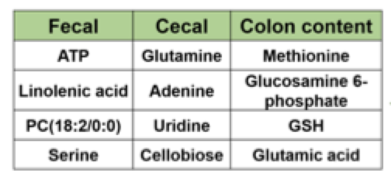
Microbiome
and IBD
Untargeted
Metabolomics
Untargeted
Metabolomics

Slide 112
Microbiome
and IBD

Slide 113
Microbiome
and IBD
Results

Slide 114
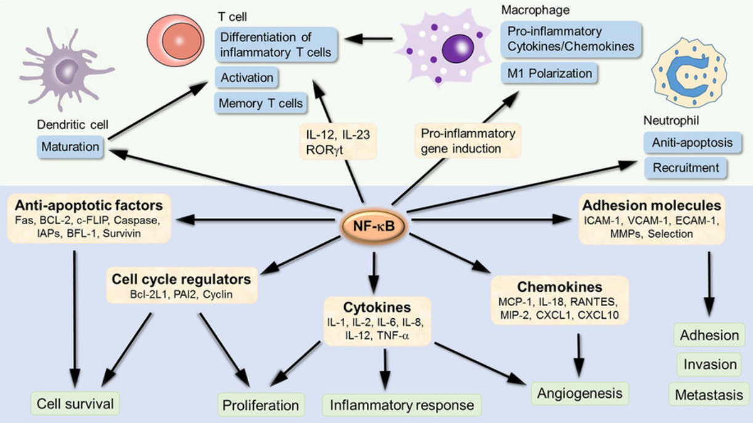
Microbiome
and IBD
Results
4 metabolites suppress inflammation
(NF-kB expression)

Slide 115
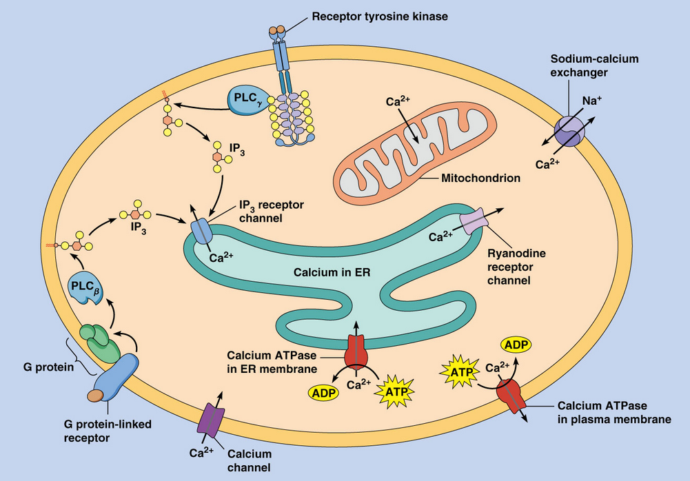
Microbiome
and IBD
Results
4 metabolites suppress inflammation
(NF-kB expression)
7 metabolites release
intracellular Ca²⁺
in macrophages

Slide 116
Technology Introduction
Sleep - METLIN ID
Stem - XCMS Online
EDCs - AI with
Neurons - Sys. Bio.
Cancer -

Slide 117
Technology Introduction
Sleep - METLIN ID
Stem - XCMS Online
EDCs - AI with
Neurons - Sys. Bio.
Cancer - Activity

Slide 118
Technology Introduction
Sleep - Activity
Stem - XCMS Online
EDCs - AI with
Neurons - Sys. Bio.
Cancer - Activity

Slide 119
Technology Introduction
Sleep - Activity
Stem - Activity
EDCs - AI with
Neurons - Sys. Bio.
Cancer - Activity

Slide 120
Technology Introduction
Sleep - Activity
Stem - Activity
EDCs - Activity
Neurons - Sys. Bio.
Cancer - Activity

Slide 121
Technology Introduction
Sleep - Activity
Stem - Activity
EDCs - Activity
Neurons - Activity
Cancer - Activity

Slide 122
Modulating
Phenotype with Metabolites

Slide 123
Modulating
Phenotype with Metabolites
Endogenous Metabolites

Slide 124
Modulating
Phenotype with Metabolites
Endogenous Metabolites
Inexpensive

Slide 125
Modulating
Phenotype with Metabolites
Endogenous Metabolites
Inexpensive
Generally Safe

Slide 126
Modulating
Phenotype with Metabolites
Endogenous Metabolites
Inexpensive
Generally Safe
Modulate Phenotype

Slide 127
Precedence

Slide 128
Precedence
Metabolite System Journal
Oleamide Sleep Science 1995
Neuroprotectin D1 Stem Cell Regulation Nature Chem. Biology 2010
TMAO Cardiac Disease Nature 2011
Nicotinamide Stem Cell Regulation Nature Chem. Biology 2013
Dimethylsphingosine Chronic Pain Nature Chem. Biology 2013
PI (20:4/20:4) Pathogen Killing Journal of Immunology 2013
FAHFAs Type 2 Diabetes Cell 2014
CMP-furanpropan. Acid Diabetes Cell Metabolism 2014
TMAO Cardiac Disease Cell 2015
Polyamines/Lipids Immuno-oncology Cell Metabolism 2015
Hexadecenoic acid Cardiovascular Disease Cell Chemical Biology 2016
Taurine Multiple Sclerosis Nature Chem. Biology 2018
Itaconate Anti-Inflammatory Nature 3/2018 Nature 4/2018

Slide 129
Precedence
Metabolite System Journal
Oleamide Sleep Science 1995
Neuroprotectin D1 Stem Cell Regulation Nature Chem. Biology 2010
TMAO Cardiac Disease Nature 2011
Nicotinamide Stem Cell Regulation Nature Chem. Biology 2013
Dimethylsphingosine Chronic Pain Nature Chem. Biology 2013
PI (20:4/20:4) Pathogen Killing Journal of Immunology 2013
FAHFAs Type 2 Diabetes Cell 2014
CMP-furanpropan. Acid Diabetes Cell Metabolism 2014
TMAO Cardiac Disease Cell 2015
Polyamines/Lipids Immuno-oncology Cell Metabolism 2015
Hexadecenoic acid Cardiovascular Disease Cell Chemical Biology 2016
Taurine Multiple Sclerosis Nature Chem. Biology 2018
Itaconate Anti-Inflammatory Nature 3/2018 Nature 4/2018

Slide 130

Primary
Message?

Slide 131
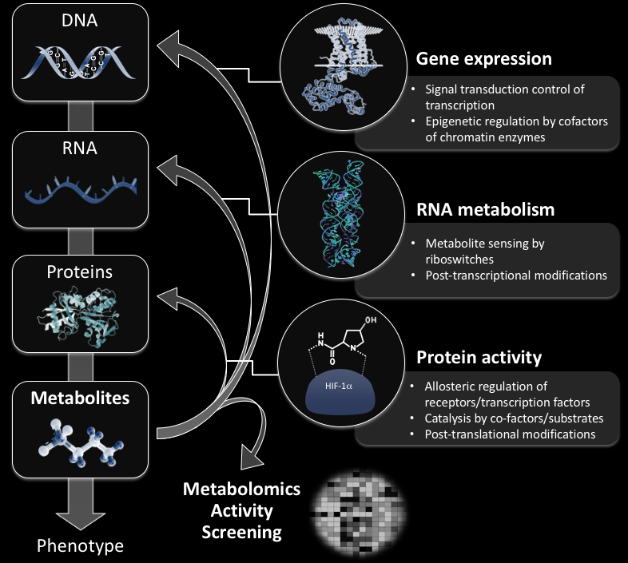

Slide 138
Primary
Message?

Slide 139
Primary
Message?
Nature Biotechnology 2018

Slide 140
Biomarkers
Pathways
Metabolomics
Primary
Message?
Nature Biotechnology 2018

Slide 141
Biomarkers
Pathways
Metabolomics
Biomarkers
Primary
Message?
Nature Biotechnology 2018

Slide 142
Biomarkers
Pathways
Metabolomics
Biomarkers
Pathways
Primary
Message?
Nature Biotechnology 2018

Slide 143
Biomarkers
Pathways
(Passive Observers)
Metabolomics
Biomarkers
Pathways
Primary
Message?
Nature Biotechnology 2018

Slide 144
Biomarkers
Pathways
(Passive Observers)
Metabolomics
Biomarkers
Pathways
Primary
Message?
Nature Biotechnology 2018

Slide 145
Biomarkers
Pathways
(Passive Observers)
Metabolomics
Biomarkers
Pathways
Active Participants
Primary
Message?
Nature Biotechnology 2018

Slide 146
Biomarkers
Pathways
(Passive Observers)
Metabolomics
Biomarkers
Pathways
Active Participants
that can
Modulate Phenotype
Primary
Message?
Nature Biotechnology 2018

Slide 147
Acknowledgements

Slide 148
Acknowledgements
NIH DOE DoD
Notes:
148

Slide 149
















Oscar Yanes
Caroline Johnson
Yale University
Carlos Guijas
Rafa Montenegro
Laura Goetz
Scripps Health
Luke Lairson
Xavi Domingo
Brittney Beyer
Richard Lerner
Ben Cravatt
Ben Warth
Aries Aisporna
Anders Nordstrom
Umea
Univ.
Tao Huan
Julijana Ivanisevic
University of Lausanne
Mary Spilker
Pfizer
Thomas Fang
Nanyang Univ.
Elizabeth Want
Imperial College
Erica Forsberg
San Diego State Univ.
Notes:
149

Slide 150








Megha Karki
H. Paul Benton
Duane Rinehart
Winnie Heim
Caroline Johnson
David
Elder
IBM - Scott Spangler
Linh Hoang
Amelia Palermo
Luke Lairson
Richard Martin
Notes:
150

